Slide 1


Rui He
6/9/2022

Slide 2

Outline
Executive Summary
Introduction
Methodology
Results
Conclusion
Appendix

Slide 3
Executive Summary
Summary of methodologies
This research acquires the data through web scrapping from wiki. Raw data acquired from wiki was first inspected for its structure and then structuralized through transformation. The structured data was used for machine learning to predict the landing success rate based on flight number, payload mass, orbit, launch site, flights, gridfins, resued, legs, landing pad, block, reuse count, and serial. Model used includes support vector machine, decision tree, logic regression, and KNN. The accuracy of model predictions was compared based on test set.

Slide 4
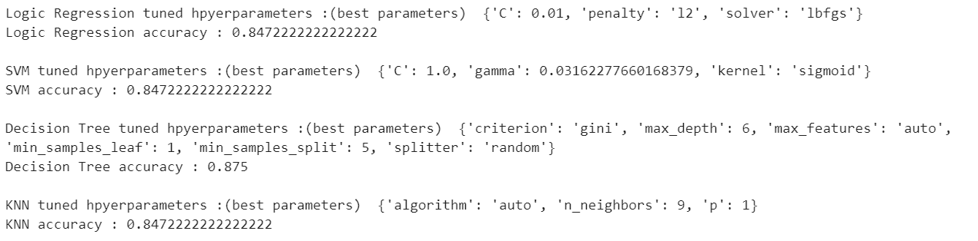
Executive Summary
Summary of all results
Results as follow. The best accuracy towards test set achieved was 0.875 using decision tree with maximum depth of 6.

Slide 5
Introduction
Project background and context
Sending things to space is expensive, and reusable rockets is a way to reduce cost. Space X is launching reusable rockets and wants to predict the success rate based on data they acquired. Considered the complex relation between features in the data, machine learning is used to perform these experiments.

Slide 6
Introduction
Problems you want to find answers
Ultimate goal is to predict if the reusable rocket can land successfully after delivering the payload to the orbit.

Slide 7

Section 1

Slide 8
Methodology
Executive Summary
Data collection methodology:
Data was acquired from Wiki using webscrapping through request method and structured with beautifulsoup.
Perform data wrangling
Empty data was replaced with mean, and data was converted to structured dataset
Perform exploratory data analysis (EDA) using visualization and SQL
Perform interactive visual analytics using Folium and Plotly Dash
Perform predictive analysis using classification models
First standardize features, then use grid search with CV=10 to find best parameters using logic regression, support vector machine, decision tree, and KNN methods.

Slide 9
Data Collection
Data set was acquired from the Wiki using web scrapping.
First request using response.json to acquire data from 'https://cf-courses-data.s3.us.cloud-object-storage.appdomain.cloud/IBM-DS0321EN-SkillsNetwork/datasets/API_call_spacex_api.json’
Then format the json to pandas dataframe using pd.json_normalize()
Data was then selected based on keywords: 'rocket', 'payloads', 'launchpad', 'cores', 'flight_number', 'date_utc’
The dataset was selected for launches with one core, one payload, and map the cores and payloads to features.
The data_utc was converted into dateime

Slide 10
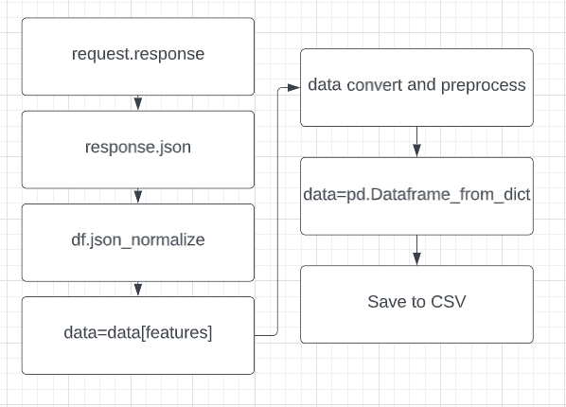
Data Collection – SpaceX API
Final keys in dataset: FlightNumber, Date,BoosterVersion, PayloadMass, Orbit, LaunchSite, Outcome, Flights, GridFins, Reused, Legs, LandingPad, Block, ReusedCount, Serial, Longtitude, Latitude
Link:
https://github.com/rhCat/IBMCouse_Capstone/blob/519fcf92e716cbb78b8d68d75b80430f4d6b05bd/Week_1_Data_acquicisium/jupyter-labs-spacex-data-collection-api.ipynb
Place your flowchart of SpaceX API calls here

Slide 11
Data Collection - Scraping
Key processes:
Request, beautifulsoup, process data
Link:
https://github.com/rhCat/IBMCouse_Capstone/blob/master/Week_1_Data_acquicisium/jupyter-labs-webscraping.ipynb
Place your flowchart of web scraping here

Slide 12
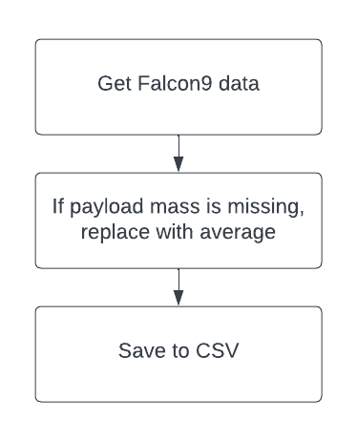
Data Wrangling
Data was selected for falcon9 only
Data with missing values are replaced with average value for payload mass
Link:
https://github.com/rhCat/IBMCouse_Capstone/blob/master/Week_1_Data_acquicisium/jupyter-labs-spacex-data-collection-api.ipynb

Slide 13
EDA with Data Visualization
Charts plotted: Payload mass versus fight number, success rate, Launch site versus flight number, Launchsite versus payload mass, barchart of orbit, scatter of orbit versus flight number, and line chart to be success rate.
https://github.com/rhCat/IBMCouse_Capstone/blob/master/Week_2_EDA/jupyter-labs-eda-dataviz.ipynb

Slide 14
EDA with SQL
Connect to database
Select everything from database
Display the names of the unique launch sites in the space mission
Display 5 records where launch sites begin with the string 'CCA'
Display the total payload mass carried by boosters launched by NASA (CRS)
Display average payload mass carried by booster version F9 v1.1
List the date when the first succesful landing outcome in ground pad was acheived.
List the names of the boosters which have success in drone ship and have payload mass greater than 4000 but less than 6000

Slide 15
EDA with SQL
List the total number of successful and failure mission outcomes
List the names of the booster_versions which have carried the maximum payload mass. Use a subquery
List the records which will display the month names, failure landing_outcomes in drone ship ,booster versions, launch_site for the months in year 2015.
Rank the count of successful landing_outcomes between the date 04-06-2010 and 20-03-2017 in descending order.
https://github.com/rhCat/IBMCouse_Capstone/blob/master/Week_2_EDA/jupyter-labs-eda-sql-coursera_sqllite.ipynb

Slide 16
Build an Interactive Map with Folium
Mark all launch sites on a mapExplain why you added those objects, Mark the success/failed launches for each site on the map, Calculate the distances between a launch site to its proximities
Plots and options are added to better view the data
https://github.com/rhCat/IBMCouse_Capstone/blob/master/Week_3_Visuak_Analytic/lab_jupyter_launch_site_location.ipynb

Slide 17
Build a Dashboard with Plotly Dash
a Launch Site Drop-down Input ComponentExplain why you added those plots and interactions, a callback function to render success-pie-chart based on selected site dropdown, a Range Slider to Select Payload, a callback function to render the success-payload-scatter-chart scatter plot
Add the GitHub URL of your completed Plotly Dash lab, as an external reference and peer-review purpose

Slide 18
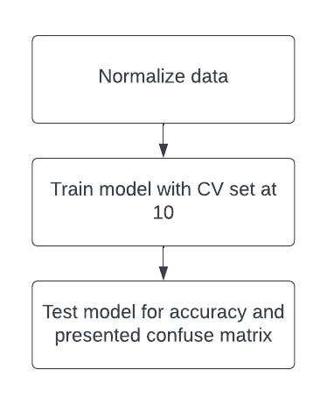
Predictive Analysis (Classification)
Logic regression, support vector machine, decision tree, and KNN was used to predict the rocket recover rate by searching the setting with CV =10
Key: Data normalization, search different parameter combination for each model to find best, and test accuracy
https://github.com/rhCat/IBMCouse_Capstone/blob/master/Week_4_Predict/SpaceX_Machine%20Learning%20Prediction_Part_5.ipynb

Slide 19
Results
EDA suggests most relevant features are: FlightNumber, PayloadMass, Orbit, LaunchSite, Flights, GridFins, Reused, Legs, LandingPad, Block, ReusedCount, Serial,
Predictive analysis results

Slide 20

Section 2

Slide 21
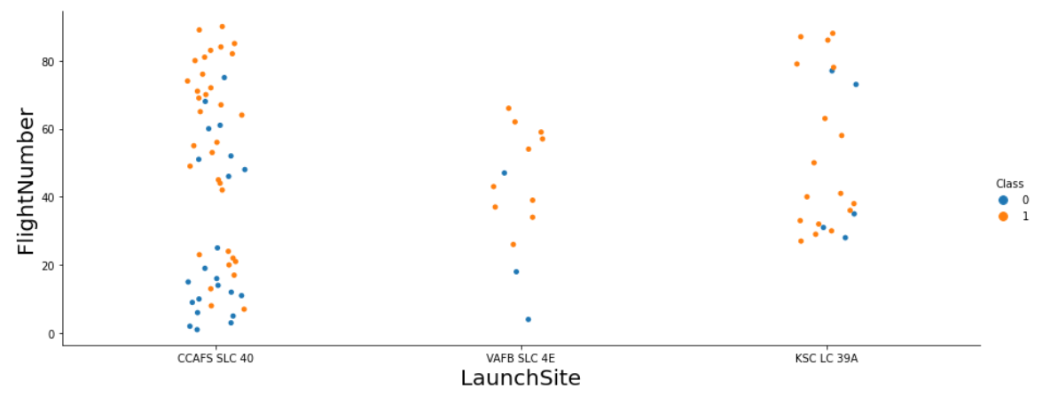
Flight Number vs. Launch Site
The result shows while most lunches were from CCAFS SLC 40 site, the success rate is lower than the other sites. It is possible that launch sites can impact the success rate.

Slide 22
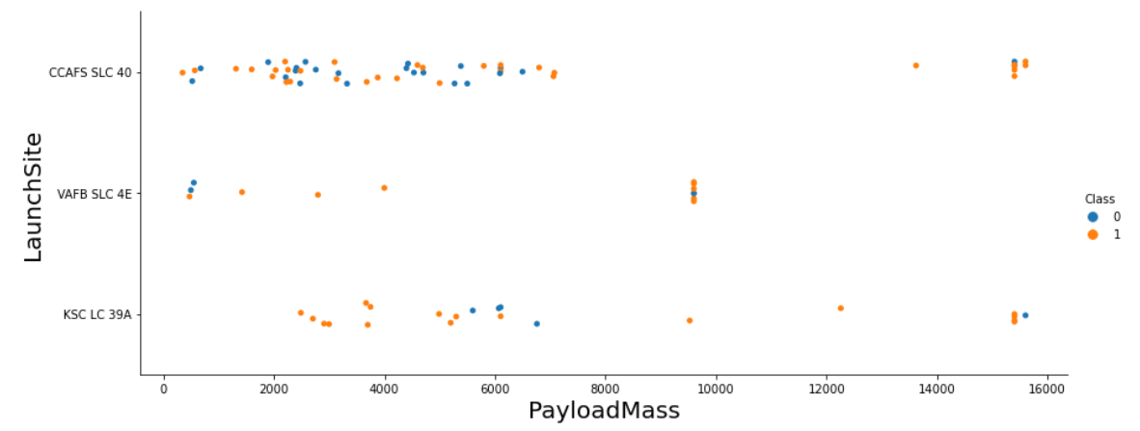
Payload vs. Launch Site
At site CCAFS SLC 40, success rate decrease with payload mass. Fro KSC LC 39A, the failure rate seemingly to be the highest at 8,000. Site VAFB SLC 4E overall have a good success rate.

Slide 23
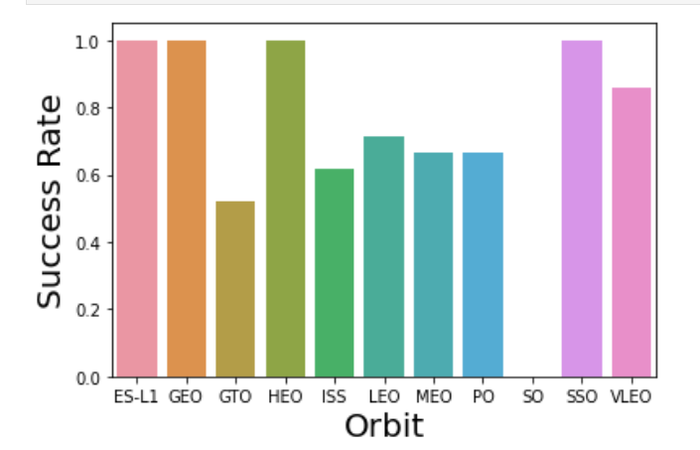
Success Rate vs. Orbit Type
Results show four types of orbit have perfect success rate while others on average share a 50% chance of success, with SO has a 0 success for 1 flight.

Slide 24
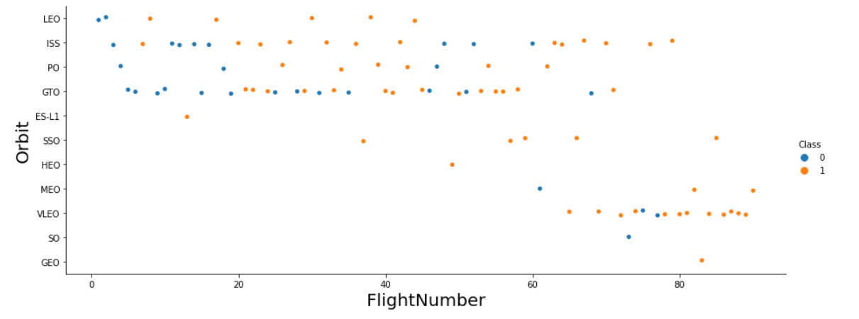
Flight Number vs. Orbit Type
The launch success rate seems to increase with higher (later) flight number on all orbits.

Slide 25
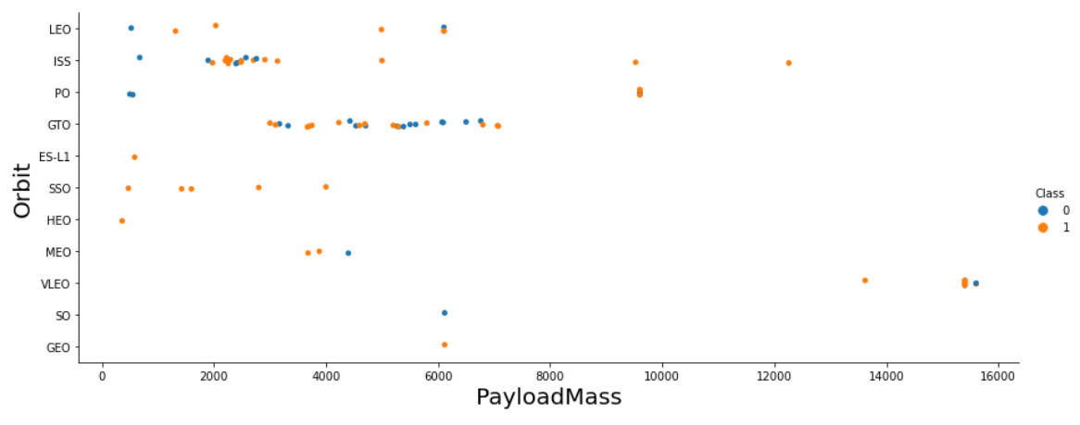
Payload vs. Orbit Type
The increase of payload mass does not seem to have an impact on success rate for different orbit type

Slide 26
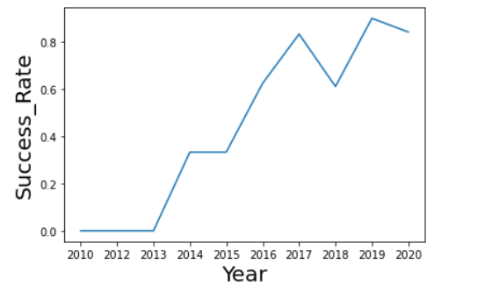
Launch Success Yearly Trend
Success rate in general increases each year.

Slide 27
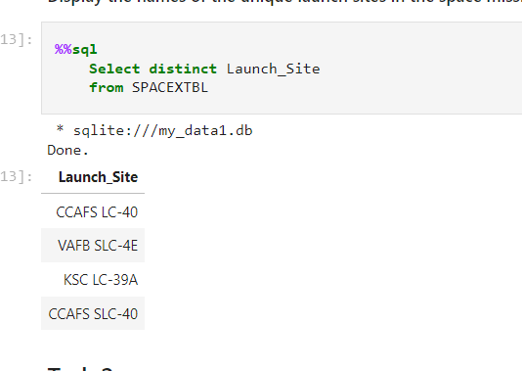
All Launch Site Names
Select distinct can be used to get unique values

Slide 28
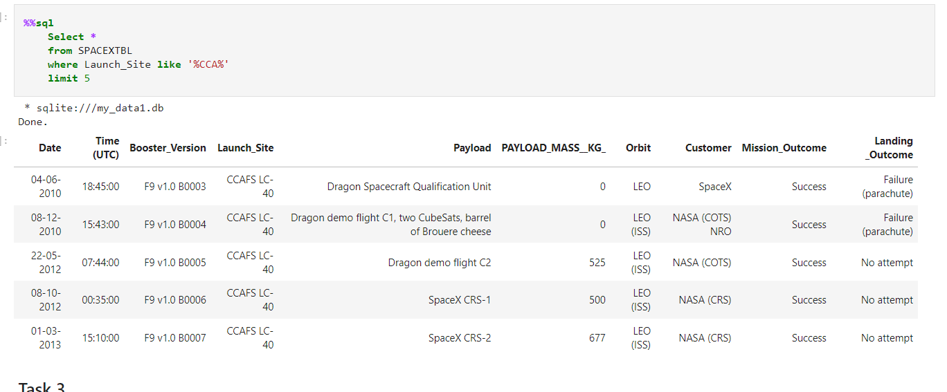
Launch Site Names Begin with 'CCA'
Where __ like ‘%string_to_find%’ is the way to do it

Slide 29
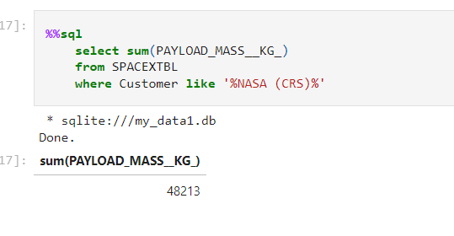
Total Payload Mass
Select sum() + where is the method to do it.

Slide 30
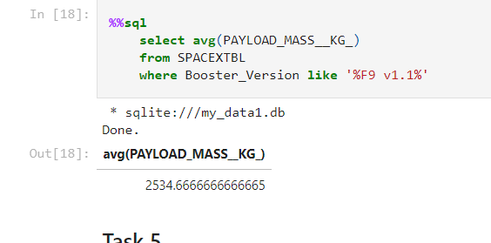
Average Payload Mass by F9 v1.1
Select avg() + where is the method to do it.

Slide 31
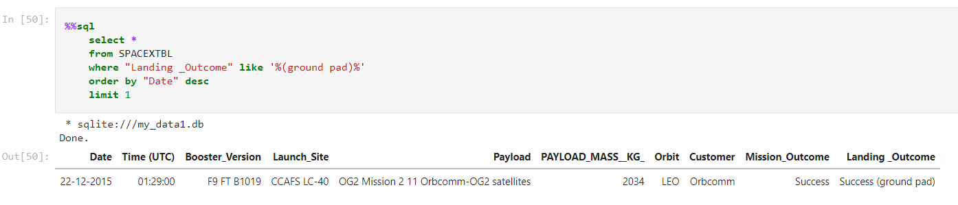
First Successful Ground Landing Date
While min() method does the job, I use sort to inspect the dataset

Slide 32
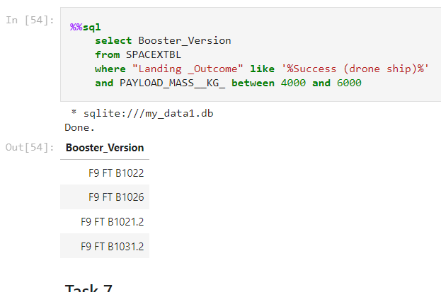
Successful Drone Ship Landing with Payload between 4000 and 6000
Use between to get the values

Slide 33
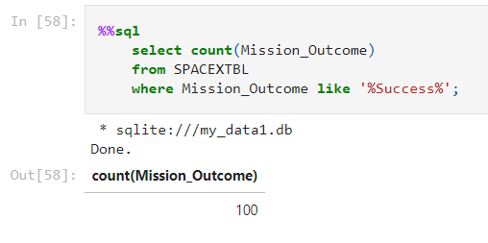
Total Number of Successful and Failure Mission Outcomes
Select count() does the job

Slide 34
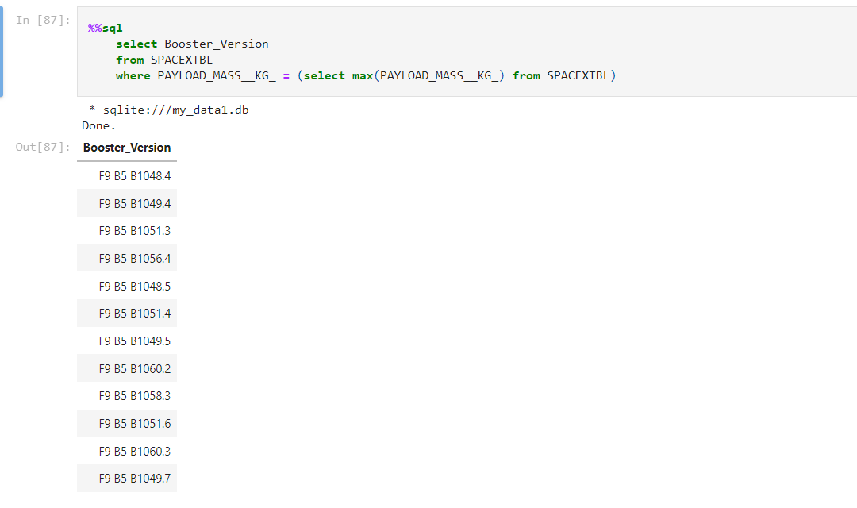
Boosters Carried Maximum Payload
Subquery with select Max can do it. In this case, it is the max payload each launch

Slide 35
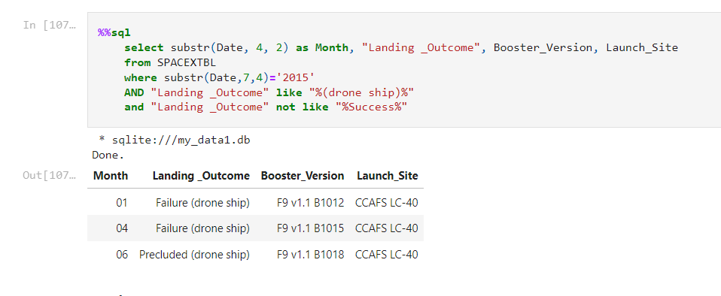
2015 Launch Records
Use and to add additional requests

Slide 36
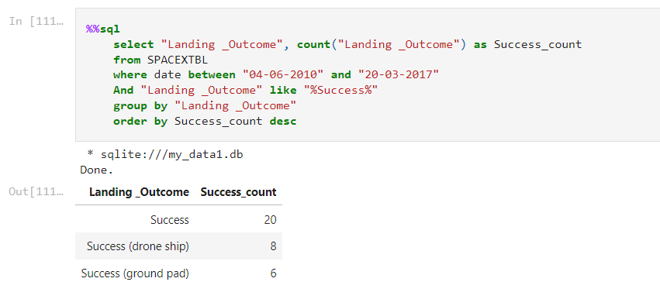
Rank Landing Outcomes Between 2010-06-04 and 2017-03-20
Use group and order to categorize and sum up results

Slide 37

Section 3

Slide 38
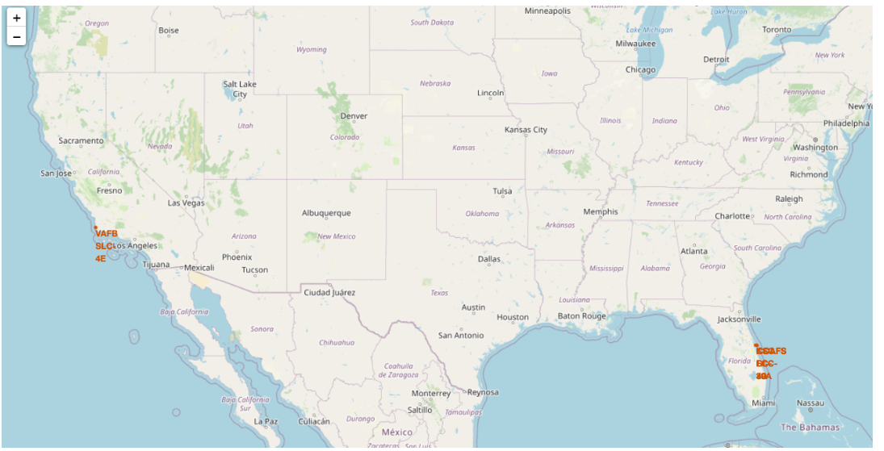
Launch Site Locations
One site at west cost, others all in Florida

Slide 39
<Folium Map Screenshot 2>
Replace <Folium map screenshot 2> title with an appropriate title
Explore the folium map and make a proper screenshot to show the color-labeled launch outcomes on the map
Explain the important elements and findings on the screenshot

Slide 40
<Folium Map Screenshot 3>
Replace <Folium map screenshot 3> title with an appropriate title
Explore the generated folium map and show the screenshot of a selected launch site to its proximities such as railway, highway, coastline, with distance calculated and displayed
Explain the important elements and findings on the screenshot

Slide 41

Section 4

Slide 42
<Dashboard Screenshot 1>
Replace <Dashboard screenshot 1> title with an appropriate title
Show the screenshot of launch success count for all sites, in a piechart
Explain the important elements and findings on the screenshot

Slide 43
<Dashboard Screenshot 2>
Replace <Dashboard screenshot 2> title with an appropriate title
Show the screenshot of the piechart for the launch site with highest launch success ratio
Explain the important elements and findings on the screenshot

Slide 44
<Dashboard Screenshot 3>
Replace <Dashboard screenshot 3> title with an appropriate title
Show screenshots of Payload vs. Launch Outcome scatter plot for all sites, with different payload selected in the range slider
Explain the important elements and findings on the screenshot, such as which payload range or booster version have the largest success rate, etc.

Slide 45

Section 5

Slide 46
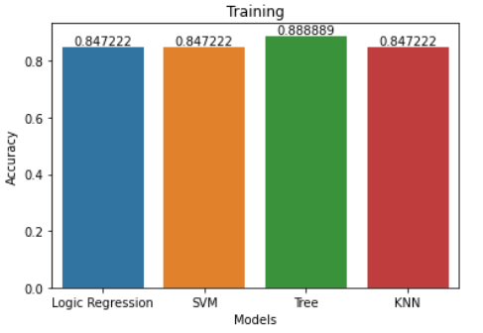
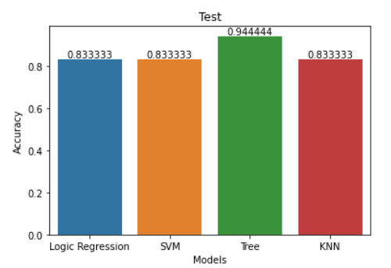
Classification Accuracy
The best result was from decision tree with training accuracy of 88.9% and test accuracy of 94.4%

Slide 47
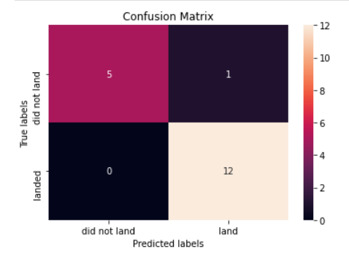
Confusion Matrix
The precision (true positive/all positive prediction)=12/13, the recall was (true positive / (true positive + false negative)) =12/12
F1 score was 2*(12/13*12/12)/(12/13+12/12)=0.96

Slide 48
Conclusions
Success rate increase with time
Success rate show dependency on complex variables
However, dataset need to be expanded to better present all cases
The decision tree best predict the success rate
Although the prediction can be used as an indicator for predicting results, it depends on precious knowledge
Selection of launching criteria still need to be depend on project requirements

Slide 49


